Slide 1
Comparison and Logical Operator

Slide 2
Comparison Operators
Comparison operators are used to compare two values. They return a Boolean value (True or False) based on the comparison. Here are the common comparison operators:
==: Equal to
Checks if the values on both sides are equal.
Example: 5 == 5 returns True.
!=: Not equal to
Checks if the values on both sides are not equal.
Example: 5 != 3 returns True.
>: Greater than
Checks if the value on the left is greater than the value on the right.
Example: 5 > 3 returns True.
<: Less than
Checks if the value on the left is less than the value on the right.
Example: 3 < 5 returns True.
>=: Greater than or equal to
Checks if the value on the left is greater than or equal to the value on the right.
Example: 5 >= 5 returns True.
<=: Less than or equal to
Checks if the value on the left is less than or equal to the value on the right.
Example: 3 <= 5 returns True.

Slide 3
Logical Operators
Logical operators are used to combine multiple Boolean expressions or values. They also return a Boolean value. Here are the common logical operators:
and: Logical AND
Returns True if both operands are True.
Example: (5 > 3) and (3 < 4) returns True.
or: Logical OR
Returns True if at least one of the operands is True.
Example: (5 > 3) or (3 > 4) returns True.
not: Logical NOT
Returns True if the operand is False, and vice versa.
Example: not (5 > 3) returns False.

Slide 4
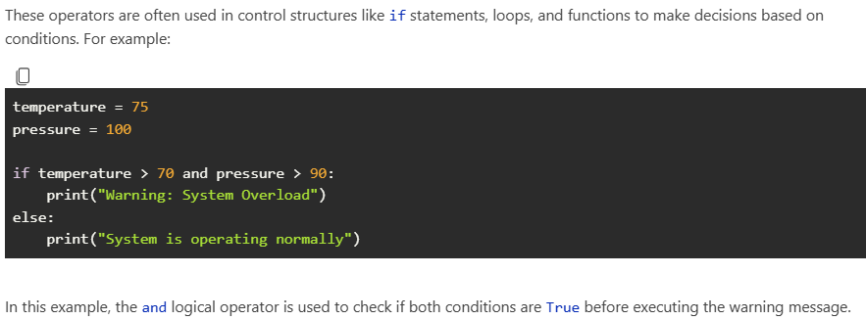
Usage in Programming

